Slide 1

ECOBITES
MEERA AMEERA

Slide 2
WHAT IS ECOBITES?
It is an app to help reduce grocery/food wastage at home.

Slide 3
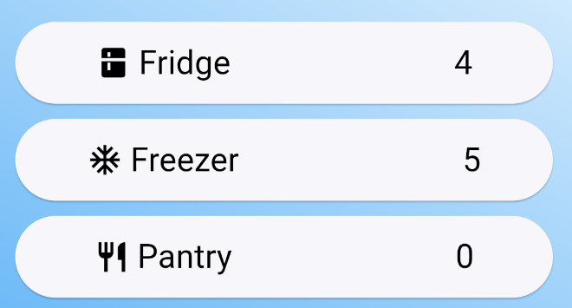
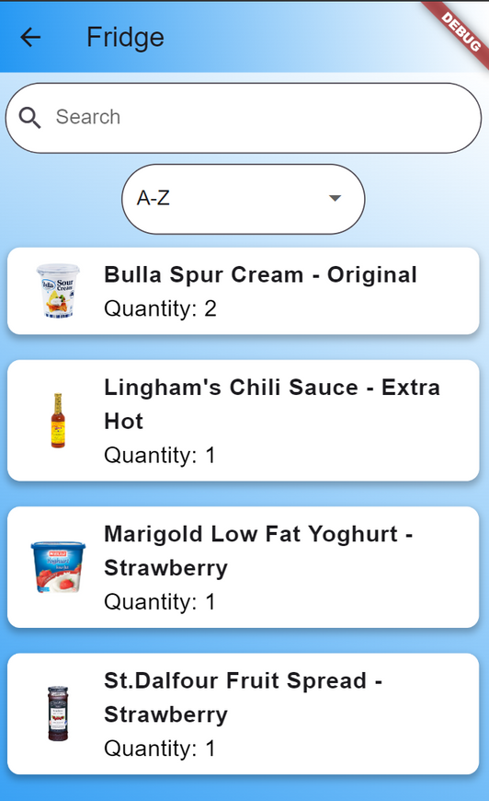
FUNCTIONALITIES
Storage Location Tracker
  Can track how many grocery items are being stored in the specific location

Slide 4
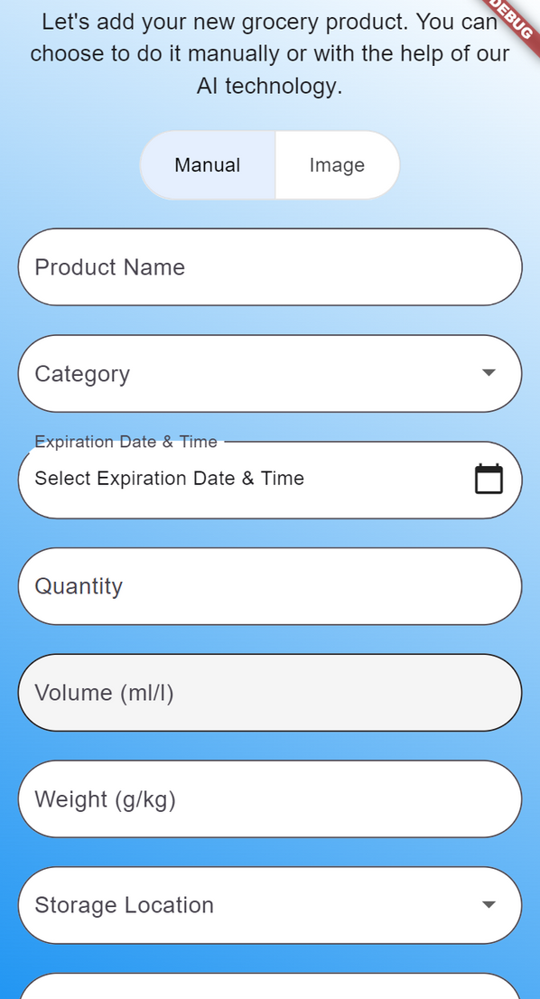
FUNCTIONALITIES
Adding Groceries
  Able to add as many grocery items as you want to the database
  For uploading images, main method is using the image URL

Slide 5
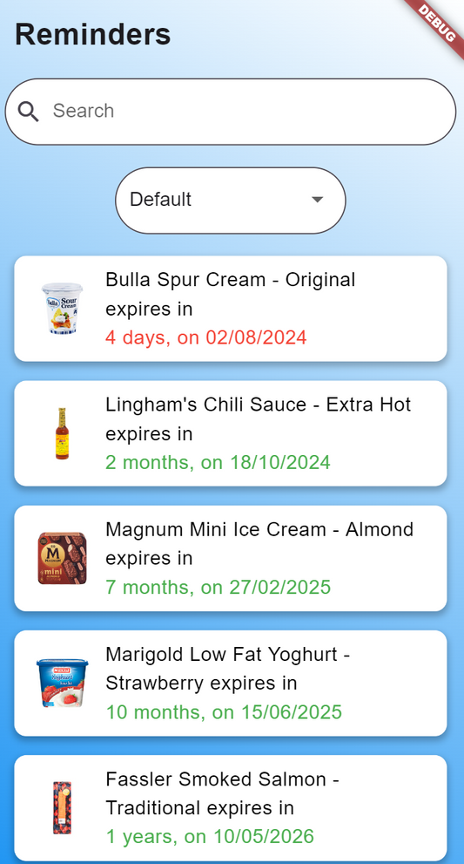
FUNCTIONALITIES
Reminders
  Will be reminded when a product is going to expire
  you can filter out to get by
    days
    weeks
    months
    years

Slide 6
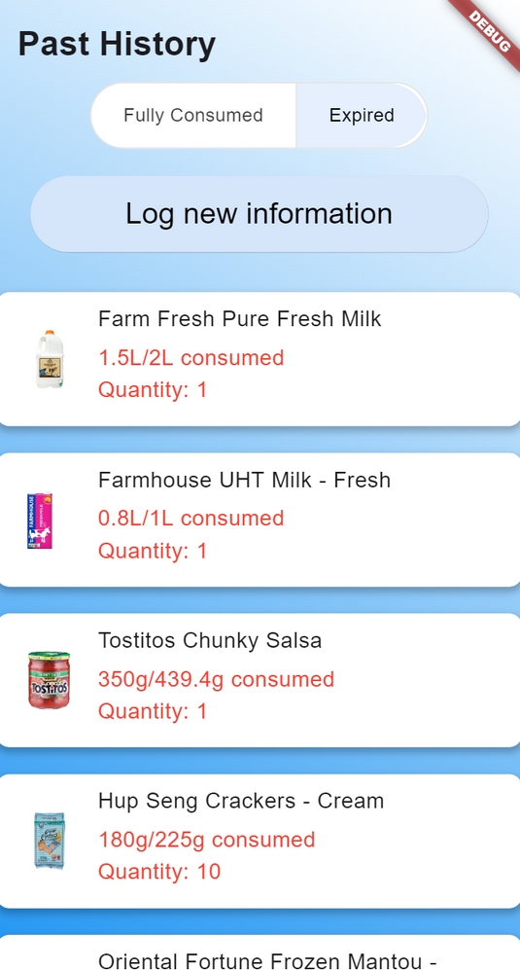
FUNCTIONALITIES
Past History
  Able to see what product you fully consumed or did not finish
  A good way to roughly gauge whether you can finish a specific product in the future

Slide 7
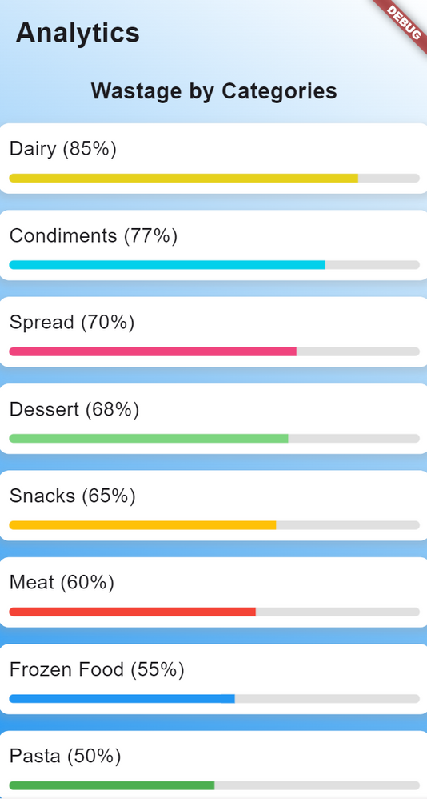
FUNCTIONALITIES
Analytics
  Products are being divided into different categories
  Able to see what percentage have you wasted for the particular category for the month

Slide 8
FUTURE ENHANCEMENT
(I tried doing but it kept hanging so I removed them...)
GOOGLE AUTHENTICATION
IMAGE PICKER
NOTIFICATIONS
It is troublesome to key in long URLs for the image, so I should allow the user to select from their gallery or snap a shot on the spot
Users may not always go into the reminders screen so they will not be aware of some products expiring soon, so I should implement in-app notifications
It is a common method of signing up or login in across all apps.

Slide 9
VIDEO RECORDING
HTTPS://YOUTU.BE/_G-GC2D0CAC?FEATURE=SHARED

Slide 10
THANK YOU VERY MUCH!

